Slide 1

LOGICAL VOLUME MANAGER
Amir Hossein Eshaghi

Slide 2
LVM can be install for the Linux operating system, Redhat, Fedora, MontaVista Linux, openSUSE, SLES, SLED, Debian GNU/Linux, and Ubuntu distributions are LVM-aware and can install a bootable system with a root filesystem on a logical volume.
Logical volume management provides a higher−level view of the disk storage on a computer system than the traditional view of disks and partitions. This gives the system administrator much more flexibility In allocating storage to applications and users.
Storage volumes created under the control of the logical volume manager can be resized and moved around
The logical volume manager also allows management of storage volumes in user−defined groups, allowing
the system administrator to deal with sensibly named volume groups such as "development" and "sales" rather than physical disk names such as "sda" and "sdb".

Slide 3
What is Linux LVM?
The Linux Logical Volume manager (LVM) is a group of applications that provides the
Administrator flexability when working with mass storage and flexibility in a number of ways than using physical storage directly.
Applications use a virtual storage, which is managed using a volume management software, a Logical Volume Manager (LVM).
LVM hides the details about where data is stored, on which actual hardware and where on that hardware, from the entire system
گروهی از برنامه های کاربردی که برای کار با مخزن های اطلاعاتی به مدیر سیستم انعطاف می دهد و
انعطاف بیشتری را به مدیر سیستم٬ برای نسبت دادن فضا به کاربران و برنامه ها می دهد.
حجمهای ذخیره سازی تحت کنترل (ال وی ام) ساخته می شوند و می توانند تغییر اندازه و به هر جا منتقل شوند.

Slide 4
Why Linux LVM?
.Performance
– Striping information across several hard drives increases I/O throughput
.Redundancy
– Making and exact copy of one drive to another drive, or ``mirroring'' enables the server to continue running even after HDD failure
.Flexability
– Partitions are dynamic; can modify partition size as necessary.
Why would I want it?
Logical volume management is traditionally associated with large installations containing many disks but it is equally suited to small systems with a single disk or maybe two
در چه مواقعی به آن نیاز داریم؟
LVM به طور کلی وابسته به پیاده سازیهایی است که شامل تعداد زیادی دیسک است. اما برای سیستمهای کوچک با یک یا دو دیسک نیز مناسب است.

Slide 5
Benefits of Logical Volume Management on a Small System :
One of the difficult decisions facing a new user installing Linux for the first time is how to partition the disk drive
If, for example the /home logical volume later filled up but there was still space available on /usr then it would be possible to shrink /usr by a few megabytes and reallocate that space to /home.
Another alternative would be to allocate minimal amounts of space for each logical volume and leave some of the disk unallocated. Then, when the partitions start to fill up, they can be expanded as necessary

Slide 6
As an example: Joe buys a PC with an 8.4 Gigabyte disk on it and installs Linux using the
Following partitioning system:
/boot /dev/hda1 10 Megabytes
swap /dev/hda2 256 Megabytes
/ /dev/hda3 2 Gigabytes
/home /dev/hda4 6 Gigabytes
This, he thinks, will maximize the amount of space available for all his MP3 files.
Some time later Joe decides to install some program.
but realizes that the root partition isn't large enough.

Slide 7
His options are not good:
Reformat the disk, change the partitioning scheme and reinstall.
2.Buy a new disk and figure out some new partitioning scheme that will require the minimum of data movement.
3. Set up a symlink farm from / to /home and install the new software on /home
With LVM this becomes much easier:
Jane buys a similar PC but uses LVM to divide up the disk in a similar manner:
/boot /dev/vg00/boot 10 Megabytes
swap /dev/vg00/swap 256 Megabytes
/ /dev/vg00/root 2 Gigabytes
/home /dev/vg00/home 6 Gigabytes

Slide 8
When she hits a similar problem she can reduce the size of /home by a gigabyte and add that space to the root partition.
Suppose that Joe and Jane then manage to fill up the /home partition as well and decide to add a new 20 Gigabyte disk to their systems.
Joe formats the whole disk as one partition (/dev/hdb1) and moves his existing /home data onto it and uses the new disk as /home. But he has 6 gigabytes unused or has to use sym links to make that disk appear as an extension of /home, say /home/joe/old−mp3s.
Jane simply adds the new disk to her existing volume group and extends her /home logical volume to include
the new disk. Or, in fact, she could move the data from /home on the old disk to the new disk and then extend the existing root volume to cover all of the old disk.

Slide 9
Benefits of Logical Volume Management on a large System :
The benefits of logical volume management are more obvious on large systems with many disk drives.
Managing a large disk farm is a time−consuming job, made particularly complex if the system contains many disks of different sizes. Balancing the (often conflicting) storage requirements of various users can be a nightmare
At lvm for large system
User groups can be allocated to volume groups and logical volumes
And simply add the new disk into an existing volume group and extend the
logical volumes as necessary.
It is also easy to take old drives out of service by moving the data from them onto newer drives −
this can be done online, without disrupting user service.

Slide 10
This includes the following :
Striping
The ability to write one file to multiple hard drives
Dynamic
Resizing partitions as necessary without downtime
Mirroring
The ability to copy verbatum information to a backup hard drive “on the fly.”
Mirrored Logical Volumes
A mirror maintains identical copies of data on different devices. When data is written to one device, it is written to a second device as well, mirroring the data. This provides protection for device failures. When one leg of a mirror fails, the logical volume becomes a linear volume and can still be accessed.
Online
Backups Create “snapshots” of your filesystems for later restoration.

Slide 11
Snapshot Volumes
The LVM snapshot feature provides the ability to create virtual images of a device at a particular instant without causing a service interruption. When a change is made to the original device (the origin) after a snapshot is taken, the snapshot feature makes a copy of the changed data area as it was prior to the change so that it can reconstruct the state of the device.
Because a snapshot copies only the data areas that change after the snapshot is created, the snapshot feature requires a minimal amount of storage. For example, with a rarely updated origin, 3-5 % of the origin's capacity is sufficient to maintain the snapshot.
Note
Snapshot copies of a file system are virtual copies, not actual media backup for a file system. Snapshots do not provide a substitute for a backup procedure.

Slide 12
Snapshot Volumes
A wonderful facility provided by LVM is 'snapshots'
Which when is an exact copy of a logical volume, frozen at some point in time
Typically this would be used when some batch processing
, a backup for instance, needs to be performed on the logical volume, but you don't want to halt a live system that is changing the data. When the snapshot device has been finished with the system administrator can just remove the device.
This facility does require that the snapshot be made at a time
Make sure to remove snapshot LVs before upgrading from LVM 1 to LVM 2.

Slide 13
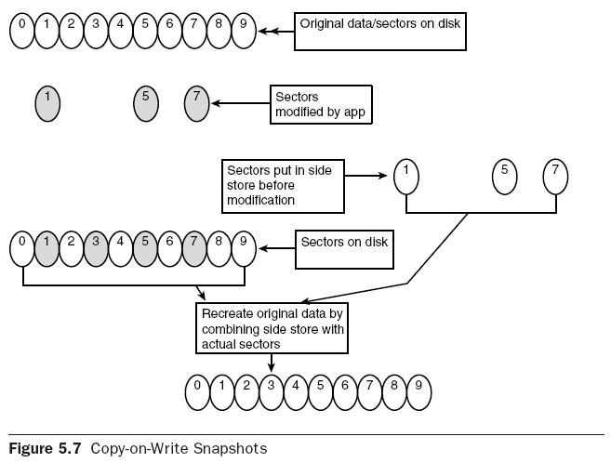
Snapshot Volumes

Slide 14
LVM Terms
.Physical Volume (Pv)
– The physical disk drive
معمولا یک هاردیسک یا چیزی شبیه با آن ( مثلا یک Raid Device )
.Physical Extent
– Partion that is defined as a member of the Logical Volume Manager.
هر PV به تکه های بزرگی از داده تقسیم می شود به نام PE
. Volume Group
– Unit described as one or more Physical Extents grouped or “bundled” to create one volume
(see diagram)
– It is possible (even likely) that a Volume Group has Physical Extents from several hard drives.
VG بالاترین سطح ظاهری است که به وسیله LVM استفاده می شود. VG مجموعه ای از LV ها و PV ها را در یک واحد مدیریتی جمع می کند.

Slide 15
. Logical Volume
– Logical unit that is “usabale” by the Administrator. The logical Volume can have a filesystem placed on it and
mounted for use:
mkfs.xfs /dev/fill/in/path/usr ; Mount /dev/fill/in/in/path/usr /usr

Slide 16
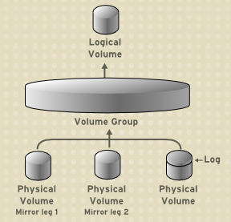
ساختمان LVM

Slide 17
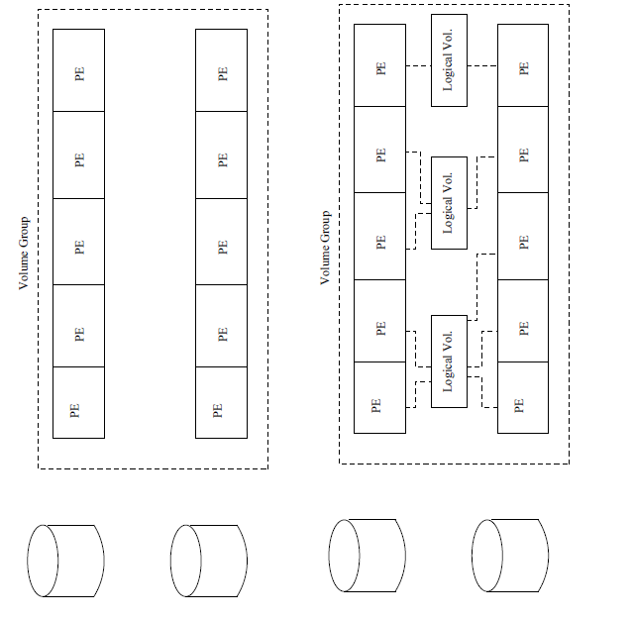
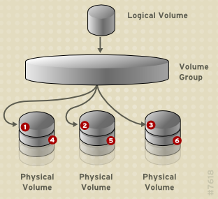
ساختمان LVM

Slide 18
ارتباط این تعاریف با هم
فرض یک VG داریم که نام آن را VG1 می گذاریم. در این VG دو پارتیشن hda1 و hdb1 را که یکی 80GB و دیگری 60 GB است٬ و PV های ما هستند اضافه می کنیم. اکنون یک فضای یک پارچه ۱۴۰ گیگابایتی داریم که می توانیم به LV های با حجم دلخواه خود تقسیم کنیم. اندازه این LV ها را در آینده نیز می توانید تغییر دهید. هر LE نیز توسط یک mapper بر روی یک PE به صورت خطی یا تصادفی نگاشت می شود.

Slide 19
ارتباط این تعاریف با هم
فرض یک VG داریم که نام آن را VG1 می گذاریم. در این VG دو پارتیشن hda1 و hdb1 را که یکی 80GB و دیگری 60 GB است٬ و PV های ما هستند اضافه می کنیم. اکنون یک فضای یک پارچه ۱۴۰ گیگابایتی داریم که می توانیم به LV های با حجم دلخواه خود تقسیم کنیم. اندازه این LV ها را در آینده نیز می توانید تغییر دهید. هر LE نیز توسط یک mapper بر روی یک PE به صورت خطی یا تصادفی نگاشت می شود.

Slide 20
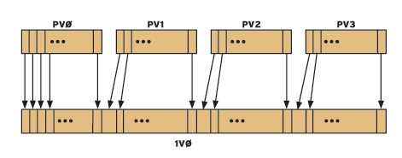
Linear Volumes
A linear volume aggregates multiple physical volumes into one logical volume. For example, if you have two 60GB disks, you can create a 120GB logical volume. The physical storage is concatenated.

Slide 21
Striped Logical Volumes
When you write data to an LVM logical volume, the file system lays the data out across the underlying physical volumes. You can control the way the data is written to the physical volumes by creating a striped logical volume. For large sequential reads and writes, this can improve the efficiency of the data I/O.
Striping enhances performance by writing data to a predetermined number of physical volumes in round-round fashion. With striping, I/O can be done in parallel.
In some situations, this can result in near-linear performance gain for each additional physical volume in the stripe.
The following illustration shows data being striped across three physical volumes. In this figure:
• the first stripe of data is written to PV0
• the second stripe of data is written to PV1
• the third stripe of data is written to PV2
• the fourth stripe of data is written to PV3
• the quintus stripe of data is written to PV0

Slide 22
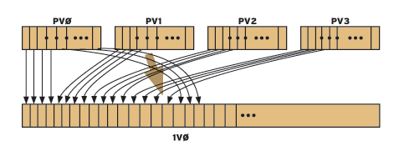
Striped Logical Volumes

Slide 23
Installation Overview in 10 step
. Partition Hard Drives
. Lay Down a Base System
.Full fill Pre requisites (Kernel Compile, User space Utilities, etc.)
. Install LVM
. Create Physical Extents
. Define Volume Groups
. Create Logical Volumes
. Create Filesystems on Physical Volumes
. Mount Physical Volumes/Move Data
. Update Init Scripts, /etc/fstab

Slide 24
your self
Partition Hard Drives
.Drive 0 (/dev/hda)
– Will use two drives
1 4.3 Gig Drive
1 2.5 Gig Drive
– 5 Partitions:
/boot: 100 MB
swap 100 MB
root 1.5 GB (will become /usr in finalconfig)
system: 600 MB
data: 200 MB
. Drive 1 (/dev/hdd)
– 3 Partitions:
swap: 100 MB
system: 1600 MB
data: 200 MB
– Note: Use of hdd keep drives on
Separate IDE chains
– Be sure to change the partition types
to type “8e” (Linux LVM) when creating
partitions targeted for LVM
Step 1

Slide 25
your self
Fullfill Prerequisites
. Compile “Logical volume manager (LVM) support” under the “Multi-device support
(RAID and LVM)” section of the kernel Compilation
. Get LVM tar.gz, RPM, apt-get, or emerge depending on your disrobution
Step 2 ,3

Slide 26
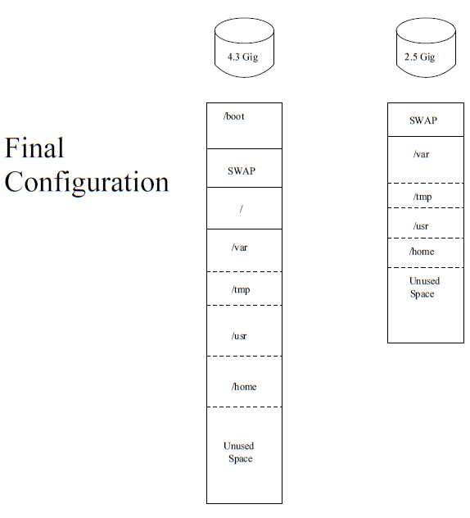

Slide 27
your self
Adding a Logical Volume
Backup
Fdisk, and change the partition system id to 8e (Linux LVM)
Pvcreate (Create Physical Volume)
Vgcreate (Create Volume group)
Lvcreate (to assign LV size)
Mkfs -j (reformat the filesystem)
Fstab (edit to suite your needs)
Mount (remount the new volume)

Slide 28
your self
Extending a Logical volume
Backup
Umount
Fdisk, and change the partition system id to 8e (Linux LVM)
Pvcreate (Create Physical Volume)
Vgextend (Extend the Volume Group)
Lvextend (Extend the LV)
Mount
Ext2online (Expand volume to the actual size)
Umount
E2fsck -f (check the filesystem)
Mount (remount the new volume)

Slide 29
your self
Removing Logical Volumes
Backup (do you need data on this volume?)
Umount (umount volume)
Lvremove (remove Logical Volume)

Slide 30
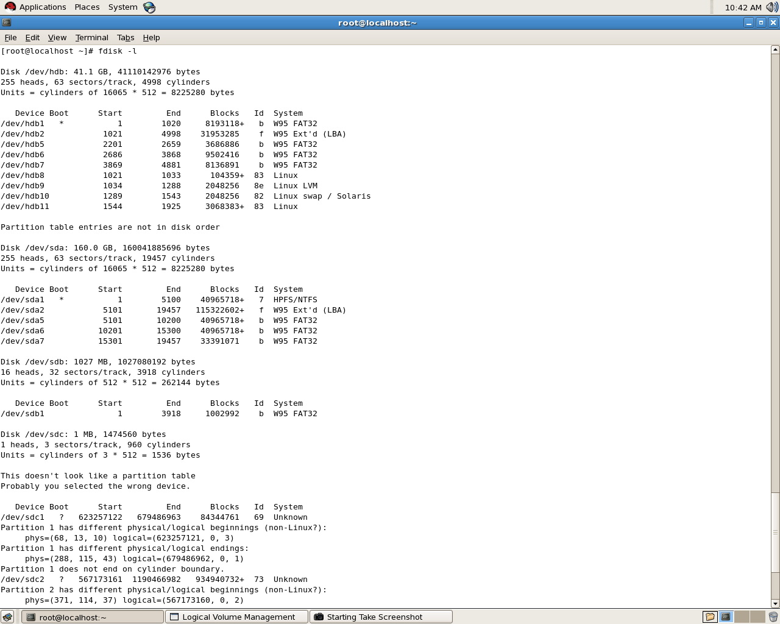
your self
Fdisk -l

Slide 31
Create Physical Extents
. pvcreate /dev/hda7 / dev/hda8
. pvcreate /dev/hdd1 /dev/hdd5 /dev/hdd6
. This tells the LVM about the partitions available for use.
Initializing Physical Volumes
Use the pvcreate command to initialize a block device to be used as a physical volume. Initialization is analogous to formatting a file system.
pvcreate /dev/sdd1 /dev/sde1 /dev/sdf1
Step 4

Slide 32
Create Volume Groups
. In this example, will create three Volume
Groups:
System
Data
Swap
1) vgcreate system /dev/hda7 /dev/hdd5
. For Display a Volume Group
# vgdisplay system
2)vgcreate data /dev/hda8 /dev/hdd6
. For Display a Volume Group
# vgdisplay data
3) Vgcreate swap /dev/hdd1
. For Display a Volume Group
# vgdisplay swap
Step 5

Slide 33
Create Logical Volumes
. Logical Volumes are the last step before we create a filesystem. Finally!!
. Basic command:
# lvcreate -n var -L 1000M
But, we would like to stripe the data for performance...
# lvcreate -n var -i 2 -I 64 system –L 900M
# lvcreate -n tmp -i 2 -I 64 system –L 200M
# lvcreate -n usr system -L 1000M
Single block for right now, will stripe during data conversion transfer.
# lvcreate -n home -i 2 -I 64 data –L 392M
# lvcreate -n swap0 swap -L 100M
Step 6

Slide 34
Create Filesystems
# mkfs.xfs /dev/system/var
# mkfs.xfs /dev/system/tmp
# mkfs.xfs /dev/system/usr
# mkfs.xfs /dev/data/home
# mkswap /dev/swap/

Slide 35
Mount Filesystems
# mkdir /mnt/tmp var
# mount /dev/system/var /mnt/tmp var
Update Init Scripts
In /etc/init.d/rc.d/rc.local (RedHat)
# vgchange -a y

Slide 36
Migrate Fileystems
# cd /var
# find . depth print—cpio pd /mnt/tmp var

Slide 37
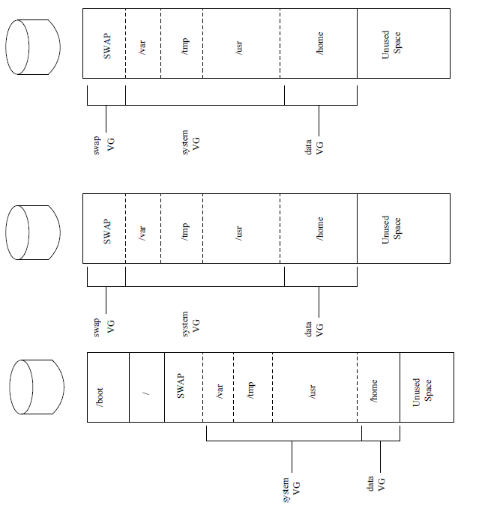

Slide 38
Scanning for Block Devices
You can scan for block devices that may be used as physical volumes with the lvmdiskscan
command, as shown in the following example.
# lvmdiskscan
/dev/ram0 [ 16.00 MB]
/dev/sda [ 17.15 GB]
/dev/root [ 13.69 GB]
/dev/ram [ 16.00 MB]
/dev/sda1 [ 17.14 GB] LVM physical volume
/dev/VolGroup00/LogVol01 [ 512.00 MB]
/dev/ram2 [ 16.00 MB]
/dev/new_vg/lvol0 [ 52.00 MB]
/dev/ram3 [ 16.00 MB]
/dev/pkl_new_vg/sparkie_lv [ 7.14 GB]
/dev/ram4 [ 16.00 MB]
/dev/ram5 [ 16.00 MB]
/dev/ram6 [ 16.00 MB]
/dev/ram7 [ 16.00 MB]
/dev/ram8 [ 16.00 MB]
/dev/ram9 [ 16.00 MB]
/dev/ram10 [ 16.00 MB]
/dev/ram11 [ 16.00 MB]
/dev/ram12 [ 16.00 MB]
/dev/ram13 [ 16.00 MB]
/dev/ram14 [ 16.00 MB]
/dev/ram15 [ 16.00 MB]
/dev/sdb [ 17.15 GB]
/dev/sdb1 [ 17.14 GB] LVM physical volume
/dev/sdc [ 17.15 GB]
/dev/sdc1 [ 17.14 GB] LVM physical volume
/dev/sdd [ 17.15 GB]
/dev/sdd1 [ 17.14 GB] LVM physical volume
7 disks
17 partitions
0 LVM physical volume whole disks
4 LVM physical volumes

Slide 39
Displaying Physical Volumes
There are three commands you can use to display properties of LVM physical volumes: pvs, pvdisplay, and pvscan.
The pvs command provides physical volume information in a configurable form, displaying one line per physical volume. The pvs command provides a great deal of format control, and is useful for scripting. For information on using the pvs command to customize your output, see Section 9, “Customized Reporting for LVM”. The pvdisplay command provides a verbose multi-line output for each physical volume. It displays physical properties (size, extents, volume group, etc.) in a fixed format. The following example shows the output of the pvdisplay command for a single physical
volume.
# pvdisplay
--- Physical volume ---
PV Name /dev/sdc1
VG Name new_vg
PV Size 17.14 GB / not usable 3.40 MB
Allocatable yes
PE Size (KByte) 4096
Total PE 4388
Free PE 4375
Allocated PE 13
PV UUID Joqlch-yWSj-kuEn-IdwM-01S9-XO8M-mcpsVe
The pvscan command scans all supported LVM block devices in the system for physical
volumes.
The following command shows all physical devices found:

Slide 40
Displaying Physical Volumes
# pvscan
PV /dev/sdb2 VG vg0 lvm2 [964.00 MB / 0 free]
PV /dev/sdc1 VG vg0 lvm2 [964.00 MB / 428.00 MB free]
PV /dev/sdc2 lvm2 [964.84 MB]
Total: 3 [2.83 GB] / in use: 2 [1.88 GB] / in no VG: 1 [964.84 MB]
You can define a filter in the lvm.conf so that this command will avoid scanning specific physical volumes. For information on using filters to control which devices are scanned, see Section 6, “Controlling LVM Device Scans with Filters”.

Slide 41
Displaying Physical Volumes
# pvscan
PV /dev/sdb2 VG vg0 lvm2 [964.00 MB / 0 free]
PV /dev/sdc1 VG vg0 lvm2 [964.00 MB / 428.00 MB free]
PV /dev/sdc2 lvm2 [964.84 MB]
Total: 3 [2.83 GB] / in use: 2 [1.88 GB] / in no VG: 1 [964.84 MB]
You can define a filter in the lvm.conf so that this command will avoid scanning specific physical volumes. For information on using filters to control which devices are scanned, see Section 6, “Controlling LVM Device Scans with Filters”.
Resizing a Physical Volume
If you need to change the size of an underlying block device for any reason, use the pvresize command to update LVM with the new size. You can execute this command while LVM is using the physical volume.
Removing Physical Volumes
If a device is no longer required for use by LVM, you can remove the LVM label with the pvremove command. Executing the pvremove command zeroes the LVM metadata on an empty physical volume. If the physical volume you want to remove is currently part of a volume group, you must remove it from the volume group with the vgreduce command, as described in Section 3.5, “Removing Physical Volumes from a Volume Group”.
# pvremove /dev/ram15
Labels on physical volume "/dev/ram15" successfully wiped

Slide 42
Creating Volume Groups
To create a volume group from one or more physical volumes, use the vgcreate command. The vgcreate command creates a new volume group by name and adds at least one physical volume to it. The following command creates a volume group named vg1 that contains physical volumes /dev/sdd1 and /dev/sde1.
vgcreate vg1 /dev/sdd1 /dev/sde1
Adding Physical Volumes to a Volume Group
To add additional physical volumes to an existing volume group, use the vgextend command. The vgextend command increases a volume group's capacity by adding one or more free physical volumes. The following command adds the physical volume /dev/sdf1 to the volume group vg1.
vgextend vg1 /dev/sdf1

Slide 43
Displaying Volume Groups
There are two commands you can use to display properties of LVM volume groups: vgs and vgdisplay. The vgscan command will also display the volume groups, although its primary purpose is to scan all the disks for volume groups and rebuild the LVM cache file. For information on the vgscan command, see Section 3.4, “Scanning Disks for Volume Groups to Build the Cache File”. The vgs command provides volume group information in a configurable form, displaying one line per volume group. The vgs command provides a great deal of format control, and is useful for scripting. For information on using the vgs command to customize your output, see Section 9, “Customized Reporting for LVM”.
The vgdisplay command displays volume group properties (such as size, extents, number of physical volumes, etc.) in a fixed form. The following example shows the output of a vgdisplay command for the volume group new_vg. If you do not specify a volume group, all existing volume groups are displayed.
# vgdisplay new_vg
--- Volume group ---
VG Name new_vg
System ID
Format lvm2
Metadata Areas 3
Metadata Sequence No 11
VG Access read/write
VG Status resizable
MAX LV 0
Cur LV 1
Open LV 0
Max PV 0
Cur PV 3
Act PV 3
VG Size 51.42 GB
PE Size 4.00 MB
Total PE 13164
Alloc PE / Size 13 / 52.00 MB
Free PE / Size 13151 / 51.37 GB
VG UUID jxQJ0a-ZKk0-OpMO-0118-nlwO-wwqd-fD5D32

Slide 44
# vgscan
Reading all physical volumes. This may take a while...
Found volume group "new_vg" using metadata type lvm2
Found volume group "officevg" using metadata type lvm2

Slide 45
Renaming a Volume Group
Use the vgrename command to rename an existing volume group. Either of the following commands renames the existing volume group vg02 to my_volume_group
vgrename /dev/vg02 /dev/my_volume_group
vgrename vg02 my_volume_group
Combining Volume Groups
Two combine two volume groups into a single volume group, use the vgmerge command. You can merge an inactive "source" volume with an active or an inactive "destination" volume if the physical extent sizes of the volume are equal and the physical and logical volume summaries of both volume groups fit into the destination volume groups limits.
The following command merges the inactive volume group my_vg into the active or inactive volume group databases giving verbose runtime information.
vgmerge -v databases my_vg

Slide 46
Moving a Volume Group to Another System
You can move an entire LVM volume group to another system. It is recommended that you use the vgexport and vgimport commands when you do this. The vgexport command makes an inactive volume group inaccessible to the system, which allows you to detach its physical volumes. The vgimport command makes a volume group accessible to a machine again after the vgexport command has made it inactive.
To move a volume group form one system to another, perform the following steps:
1. Make sure that no users are accessing files on the active volumes in the volume group, then unmount the logical volumes.
2. Use the -a n argument of the vgchange command to mark the volume group as inactive, which prevents any further activity on the volume group.
3. Use the vgexport command to export the volume group. This prevents it from being accessed by the system from which you are removing it.
After you export the volume group, the physical volume will show up as being in an exported
volume group when you execute the pvscan command, as in the following example.
[root@tng3-1]# pvscan
PV /dev/sda1 is in exported VG myvg [17.15 GB / 7.15 GB free]
PV /dev/sdc1 is in exported VG myvg [17.15 GB / 15.15 GB free]
PV /dev/sdd1 is in exported VG myvg [17.15 GB / 15.15 GB free]
When the system is next shut down, you can unplug the disks that constitute the volume
group and connect them to the new system.
4. When the disks are plugged into the new system, use the vgimport command to import the volume group, making it accessible to the new system.
5. Activate the volume group with the -a y argument of the vgchange command.
6. Mount the file system to make it available for use.

Slide 47
Removing Physical Volumes from a Volume Group
To remove unused physical volumes from a volume group, use the vgreduce command. The vgreduce command shrinks a volume group's capacity by removing one or more empty physical volumes. This frees those physical volumes to be used in different volume groups or to be removed from the system. Before removing a physical volume from a volume group, you can make sure that the physical volume is not used by any logical volumes by using the pvdisplay command.
# pvdisplay /dev/hda1
-- Physical volume ---
PV Name /dev/hda1
VG Name myvg
PV Size 1.95 GB / NOT usable 4 MB [LVM: 122 KB]
PV# 1
PV Status available
Allocatable yes (but full)
Cur LV 1
PE Size (KByte) 4096
Total PE 499
Free PE 0
Allocated PE 499
PV UUID Sd44tK-9IRw-SrMC-MOkn-76iP-iftz-OVSen7
If the physical volume is still being used you will have to migrate the data to another physical volume using the pvmove command. Then use the vgreduce command to remove the physical volume:
The following command removes the physical volume /dev/hda1 from the volume group my_volume_group.
# vgreduce my_volume_group /dev/hda1

Slide 48
Removing Volume Groups
To remove a volume group that contains no logical volumes, use the vgremove command.
# vgremove officevg
Volume group "officevg" successfully removed

Slide 49
Creating Linear Volumes
When you create a logical volume, the logical volume is carved from a volume group using the free extents on the physical volumes that make up the volume group. Normally logical volumes use up any space available on the underlying physical volumes on a next-free basis. Modifying the logical volume frees and reallocates space in the physical volumes.
The following command creates a logical volume 10 gigabytes in size in the volume group vg1.
lvcreate -L 10G vg1
The following command creates a 1500 megabyte linear logical volume named testlv in the volume group testvg, creating the block device /dev/testvg/testlv.
lvcreate -L1500 -ntestlv testvg
The following command creates a 50 gigabyte logical volume named gfslv from the free extents in volume group vg0.
lvcreate -L 50G -n gfslv vg0
You can use the -l argument of the lvcreate command to specify the size of the logical volumein extents. You can also use this argument to specify the percentage of the volume group to use for the logical volume. The following command creates a logical volume called mylv that uses 60% of the total space in volume group testvol.
lvcreate -l 60%VG -n mylv testvg
You can also use the -l argument of the lvcreate command to specify the percentage of the remaining free space in a volume group as the size of the logical volume. The following command creates a logical volume called yourlv that uses all of the unallocated space in the volume group testvol.
lvcreate -l 100%FREE -n yourlv testvg

Slide 50
Creating Striped Volumes
The following command creates a striped logical volume across 2 physical volumes with a stride of 64kB. The logical volume is 50 gigabytes in size, is named gfslv, and is carved out of volume group vg0.
lvcreate -L 50G -i2 -I64 -n gfslv vg0
As with linear volumes, you can specify the extents of the physical volume that you are using for the stripe. The following command creates a striped volume 100 extents in size that stripes across two physical volumes, is named stripelv and is in volume group testvg. The stripe will use sectors 0-50 of /dev/sda1 and sectors 50-100 of /dev/sdb1.
# lvcreate -l 100 -i2 -nstripelv testvg /dev/sda1:0-50 /dev/sdb1:50-100
Using default stripesize 64.00 KB
Logical volume "stripelv" created

Slide 51
Creating Mirrored Volumes
When you create a mirrored volume, you specify the number of copies of the data to make with the -m argument of the lvcreate command. Specifying -m1 creates one mirror, which yields two copies of the file system: a linear logical volume plus one copy. Similarly, specifying -m2 creates two mirrors, yielding three copies of the file system.
The following command creates a mirrored logical volume with a single mirror. The volume is 50 gigabytes in size, is named mirrorlv, and is carved out of volume group vg0:
lvcreate -L 50G -m1 -n gfslv vg0
The following command creates a mirrored logical volume from the volume group bigvg. The logical is named ondiskmirvol and has a single mirror. The volume is 12MB in size and keeps the mirror log in memory.
# lvcreate -L 12MB -m1 --corelog -n ondiskmirvol bigvg
Logical volume "ondiskmirvol" created

Slide 52
Renaming Logical Volumes
To rename an existing logical volume, use the lvrename command. Either of the following commands renames logical volume lvold in volume group vg02 to lvnew.
lvrename /dev/vg02/lvold /dev/vg02/lvnew
lvrename vg02 lvold lvnew
Removing Logical Volumes
To remove an inactive logical volume, use the lvremove command. You must close a logical volume with the umount command before it can be removed. In addition, in a clustered environment you must deactivate a logical volume before it can be removed. If the logical volume is currently mounted, unmount the volume before removing it.
The following command removes the logical volume /dev/testvg/testlv. from the volume group testvg. Note that in this case the logical volume has not been deactivated.
[root@tng3-1 lvm]# lvremove /dev/testvg/testlv
Do you really want to remove active logical volume "testlv"? [y/n]: y
Logical volume "testlv" successfully removed

Slide 53
Displaying Logical Volumes
There are three commands you can use to display properties of LVM logical volumes: lvs, lvdisplay, and lvscan. The lvs command provides logical volume information in a configurable form, displaying one line per logical volume. The lvs command provides a great deal of format control, and is useful for scripting. For information on using the lvs command to customize your output, see Section 9, “Customized Reporting for LVM”. The lvdisplay command displays logical volume properties (such as size, layout, and mapping)
in a fixed format.
The following command shows the attributes of lvol2 in vg00. If snapshot logical volumes have been created for this original logical volume, this command shows a list of all snapshot logical volumes and their status (active or inactive) as well.
lvdisplay -v /dev/vg00/lvol2
The lvscan command scans for all logical volumes in the system and lists them, as in the following example.
# lvscan
ACTIVE '/dev/vg0/gfslv' [1.46 GB] inherit

Slide 54
Growing Logical Volumes
To increase the size of a logical volume, use the lvextend command. After extending the logical volume, you will need to increase the size of the associated file system to match.
When you extend the logical volume, you can indicate how much you want to extend the volume, or how large you want it to be after you extend it. The following command extends the logical volumne /dev/myvg/homevol to 12 gigabytes.
# lvextend -L12G /dev/myvg/homevol
lvextend -- extending logical volume "/dev/myvg/homevol" to 12 GB
lvextend -- doing automatic backup of volume group "myvg"
lvextend -- logical volume "/dev/myvg/homevol" successfully extended
The following command adds another gigabyte to the logical volume /dev/myvg/homevol.
# lvextend -L+1G /dev/myvg/homevol
lvextend -- extending logical volume "/dev/myvg/homevol" to 13 GB
lvextend -- doing automatic backup of volume group "myvg"
lvextend -- logical volume "/dev/myvg/homevol" successfully extended

Slide 55
Mount
# mkdir /mnt/test
# mount /dev/TestVG/TestLV /mnt/test
# df -h /mnt/test Filesystem Size Used Avail Use% Mounted on
/dev/mapper/TestVG-TestLV
2.3G 36M 2.2G 2% /mnt/test

Slide 56
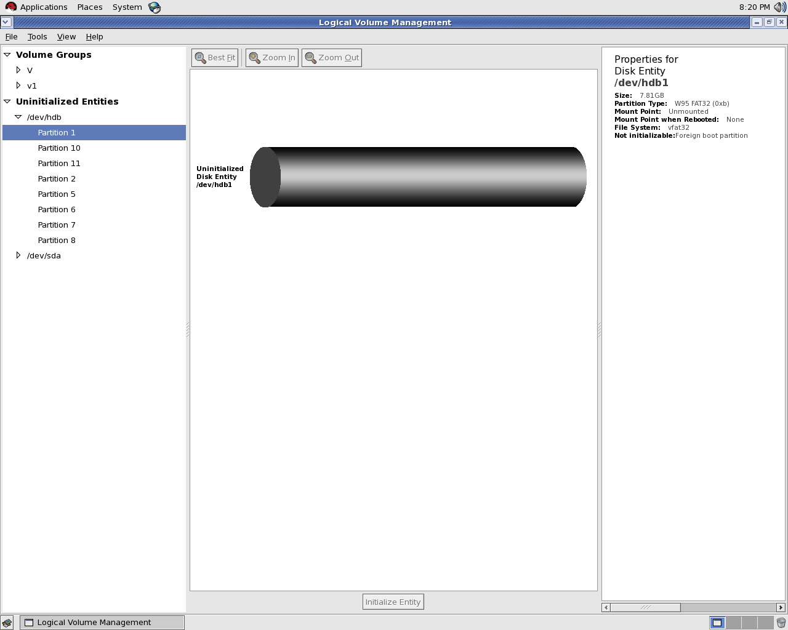

Slide 57
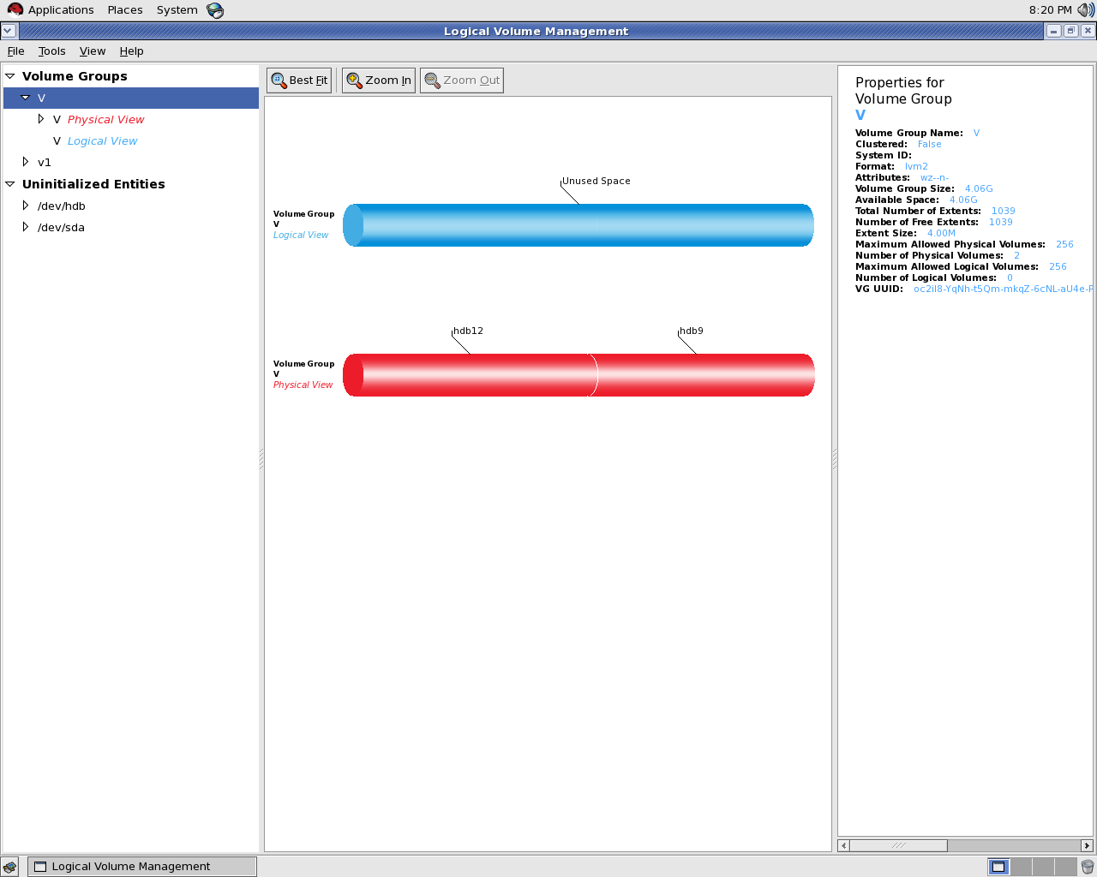

Slide 58
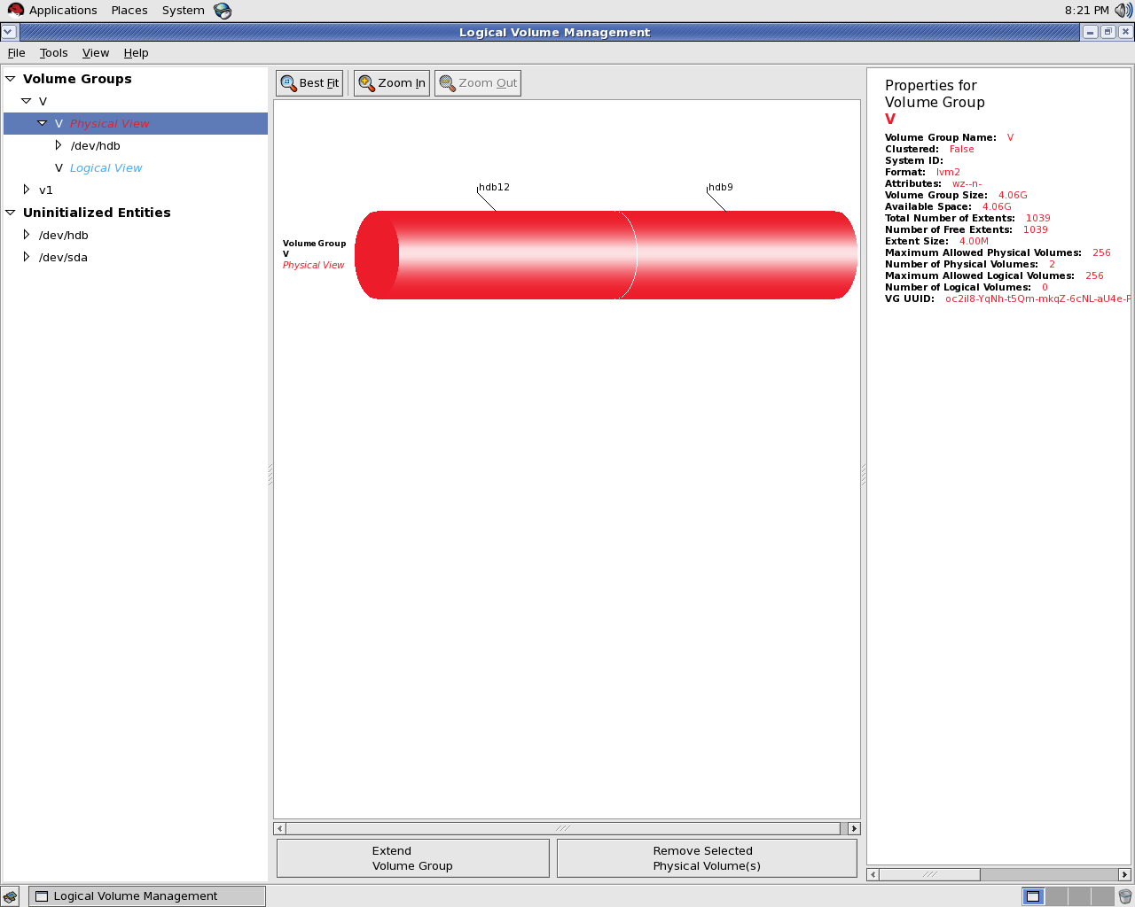

Slide 59
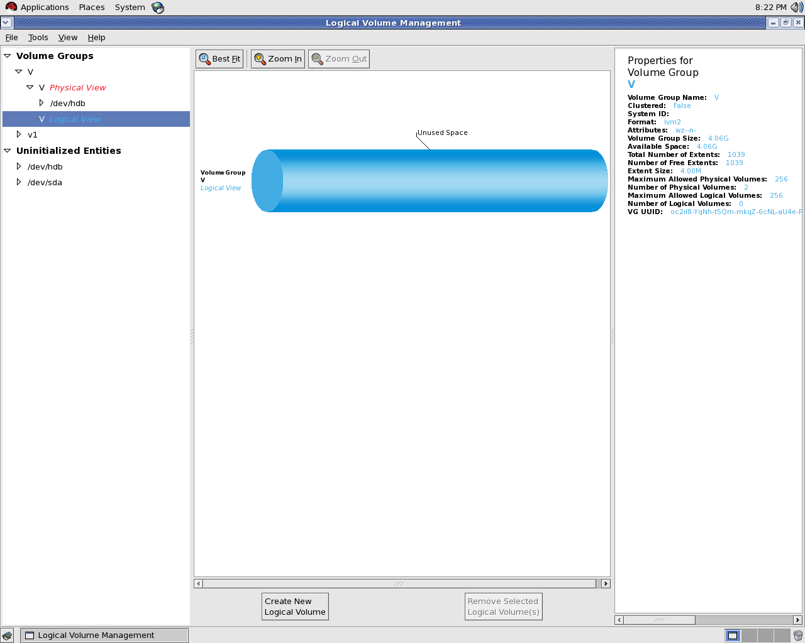

Slide 60
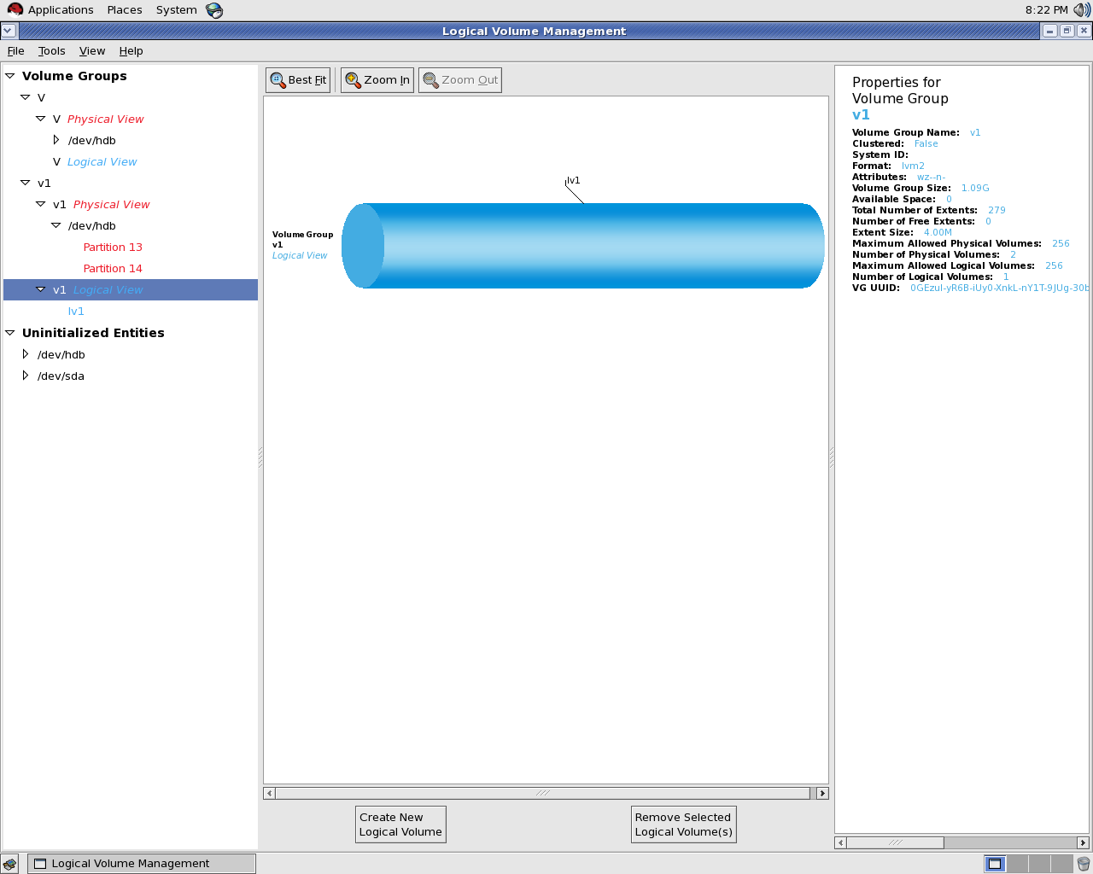

Slide 61
